Slide 1
WELCOME

Slide 2
INTRODUCTION:
Afroza Akter Choity
Assistance Teacher
61 Baraipara Govt Primary School,
Naria, Shariatpur.
LESSON IDENTITY:
English For Today
Class- Three
50 min

Slide 3
How are you ?
Lets sing together….

Slide 4
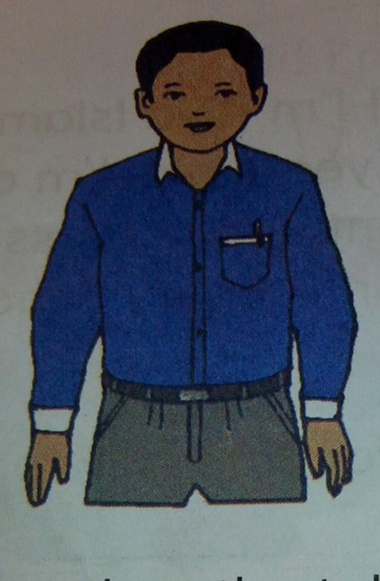
Look at the picture.

Slide 5
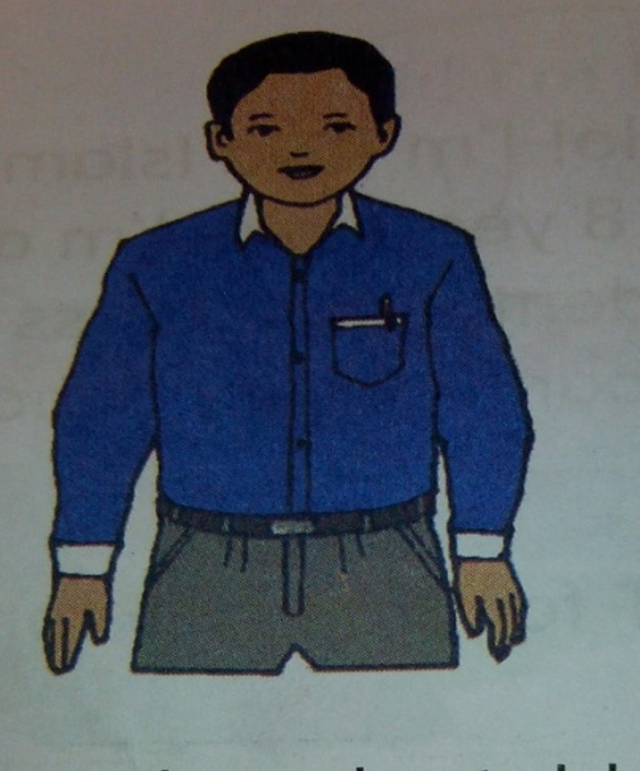
Lesson declaration:
Introducing a teacher

Slide 6
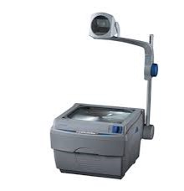
Teacher’s Materials
TEXT BOOK
CD/ADUIO
PICTURE OF TEXT

Slide 7
Learning outcome-
LISTENING:
3.1.1 Understand simple questions about students, family and friends.
3.3.1 Understand statements.
READING:
1.5.1 Read simple sentences with proper pronunciation and stress.
5.1.3 Read texts.

Slide 8
This is Mahbub Alam. He’s 30 years old. He’s an English teacher. He works in a primary school in Narail.

Slide 9
Listen to this audio….
Again…

Slide 10
This is Mahbub Alam.
He’s is 30 years old.
He’s an English teacher.
He works in a primary school in Narail.
Read with me

Slide 11
This is Mahbub Alam.
He’s is 30 years old.
He’s an English teacher.
He works in a primary school in Narail.
Again…

Slide 12
Open your EFT Text book
(Page:4)

Slide 13
Now read in pair.

Slide 14
B. Complete the table with Mahbub’s information.
Name:
Mahbub Alam
Age:
30 years
Job:
Teacher
Work place:
Primary school

Slide 15
Evaluation
Age
Mahbub Alam
Work place
30 years
Name
Teacher
Job
Primary school

Slide 16
B. Complete the table with your father’s information.
Name:
Age:
Job:
Work place:

Slide 17
THANKS FOR BEING WITH ME.
TAKE CARE.

